Slide 1

Indian Institute of Information Technology Kalyani
6th Semester Project (CS – 691)
DIABETIC RETINOPATHY DETECTION
Mentored By – Mr. Anirban Lakshman

Slide 2
MEMBERS
Akash Ramanand Rajak 435 19008
Amaan Khan 438 19011
Pallav Dubey 481 19054
Kumar Saurabh 470 19043

Slide 3
What is Diabetic Retinopathy?
Diabetic retinopathy, also known as diabetic eye disease (DED), is a medical condition in which damage occurs to the retina due to diabetes.
It is a leading cause of blindness in developed countries.
It's a diabetic complication that affects eyes, caused by damage to the blood vessels of the light sensitive tissue at the back of the eye (retina).
It also affects up to 80 % of those who have had diabetes for >= 20 years.

Slide 4
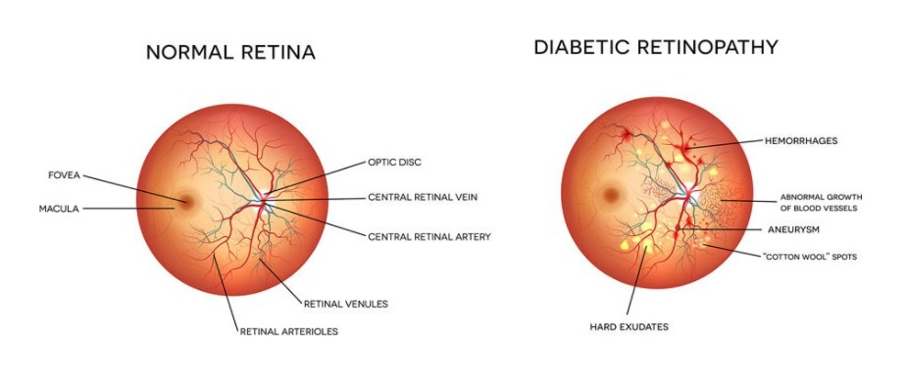
Sign and Symptoms
Diabetes is the common symptom in all patients.
Development of dark spots, blurred vision, empty areas in the vision
Vision disorder and difficulty in perceiving colours.

Slide 5
Why this topic?
There are about 422 million diabetic patients across the world and we even can’t determine how many of them are suffering from diabetic retinopathy.
There is so much technology which have been invented for our comfort, good health and well being.
But the problem is that these technologies could be only afforded by financially sound people. The rest remains untreated without any good report because of lack of technology.
Therefore, propose a model which could identify a specific type of disease and classify them on their severity level and give a quick report to the doctor without taking time and money for its analysis.

Slide 6
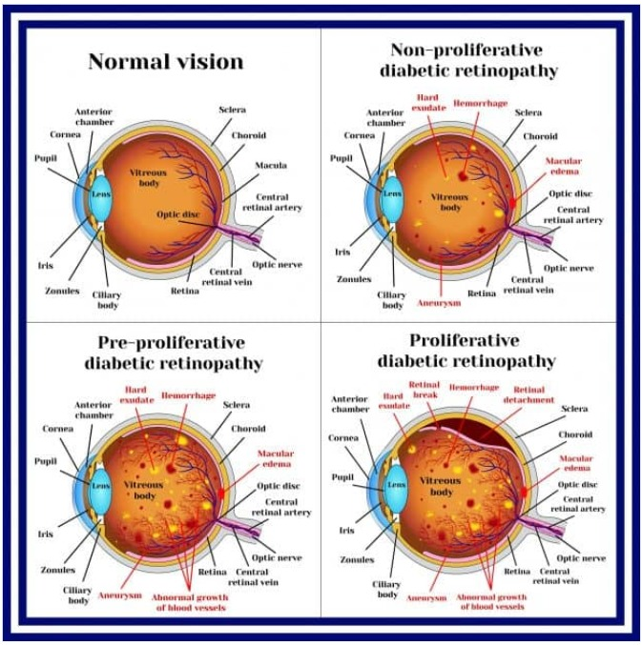
Stages and how they look like

Slide 7
My Objective
To create a model which classifies between different types of diabetic retinopathy patient eye ball images, learn to classify, and make future classifications based on new data provided with as high accuracy as possible.

Slide 8
Weekly Update
This presentation is to keep track of updates and changes to the project regarding various features added and deployed to the project content.
The presentation will help the group members to handle the work flow with efficiency.

Slide 9
Week 1
The discussion regarding the project began as soon as the topic was chosen.
In discussion, we have created the total workflow of the project as follows.
Dataset finding for the model
Data preprocessing and modifications
model creation
model training on training dataset
model testing on test dataset
predicting on new input data and analyzing the result
wrapping everything in GUI interface

Slide 10
Week 1
We are working on finding a suitable dataset for our model and how to use it in our model.
As most of the datasets are of very big size, we are trying to find a cloud based dataset and how to directly use that particular dataset for our model.

Slide 11
Week 2
In this week, we have found a very awesome and interactive platform google colab.
Colab is a free Jupyter notebook environment that runs entirely in the cloud. Most importantly, the notebooks that we create here can be simultaneously edited by our team members.
It already supports many important machine learning libraries like Integrate PyTorch, TensorFlow, Keras, OpenCV
We can easily import files and external datasets from Google drive, GitHub, Kaggle etc.
It provides us a huge RAM and storage on the server as well as with a free GPU.

Slide 12
Week 2
Firstly, We have set up our google colab and gave permission for editing to all the team members.
Then, We have fetched the dataset into colab using the API provided with the Kaggle dataset itself.
After importing the Dataset, we have thoroughly examined all the files and folders present in the dataset.
And now we are trying to apply some preprocessing techniques in the files and folders present in the dataset to make it useful for our model.

Slide 13
Week 3
Since in google colab, everytime we open the code we need to run the whole code and everytime we need to download the dataset from drive using the online code from Kaggle.
So we decided to move to Jupyter notebook, and since the dataset was of size 8 GB so we downloaded the dataset on local system and given the path of the local system data set rather than online one.
Now in the earlier week, we had done till the reading data and data cleaning, this time we have updated till the model creation.

Slide 14
Model Creation
After cleaning the data we have visualized the data using graph. Which is done by matplotlib.plt library in python.
Then after preprocessing we have trained the model using SVC algorithm.
The objective of a Linear SVC (Support Vector Classifier) is to fit to the data you provide, returning a "best fit" hyperplane that divides, or categorizes, your data. From there, after getting the hyperplane, you can then feed some features to your classifier to see what the "predicted" class is..
SVC is a nonparametric clustering algorithm that does not make any assumption on the number or shape of the clusters in the data.

Slide 15
Then we tested the trained model with the K neighbour classifier algorithm.
The k-nearest neighbors (KNN) algorithm is a simple, supervised machine learning algorithm that can be used to solve both classification and regression problems. It's easy to implement and understand, but has a major drawback of becoming significantly slows as the size of that data in use grows.
K-NN algorithm assumes the similarity between the new case/data and available cases and put the new case into the category that is most similar to the available categories.
It is also called a lazy learner algorithm because it does not learn from the training set immediately instead it stores the dataset and at the time of classification, it performs an action on the dataset.
And got the accuracy score of almost 94-95%.

Slide 16
What we are going to do ahead
Now since model is trained and we have tested it, so now we will go the frontend part and will create some GUI based window which will allows user to select the images of retina from the local system and then with that image will find whether it has DR or not.
And after that will also improve the code, to detect which type of DR is patient suffering with it he/she has one.

Slide 17
Week 4
Since in the earlier week we had implemented till the model creation part, this week we updated with the GUI configuration.
Using tkinter library in python, we created a GUI window for testing the model with local datasets.
After the training part is done, we started the code for tkinter GUI part and GUI is formed in such a way :
User will be asked to select the left and corresponding right retina images of eye and then go for the detection part.

Slide 18
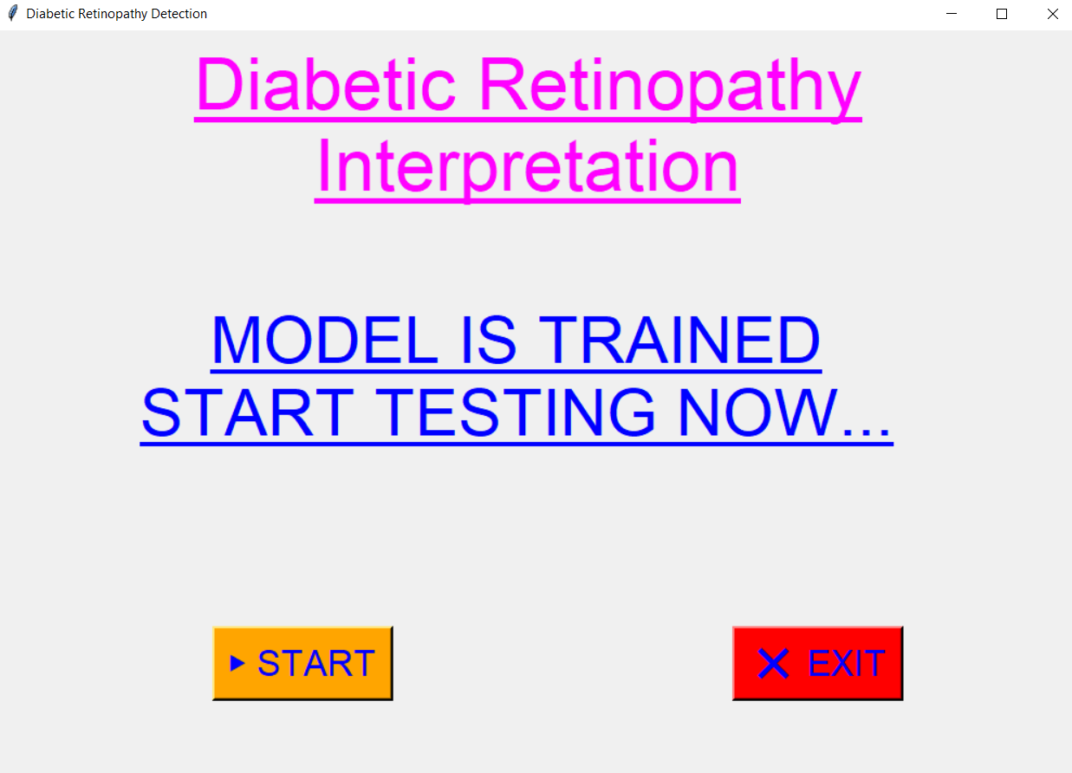

Slide 19
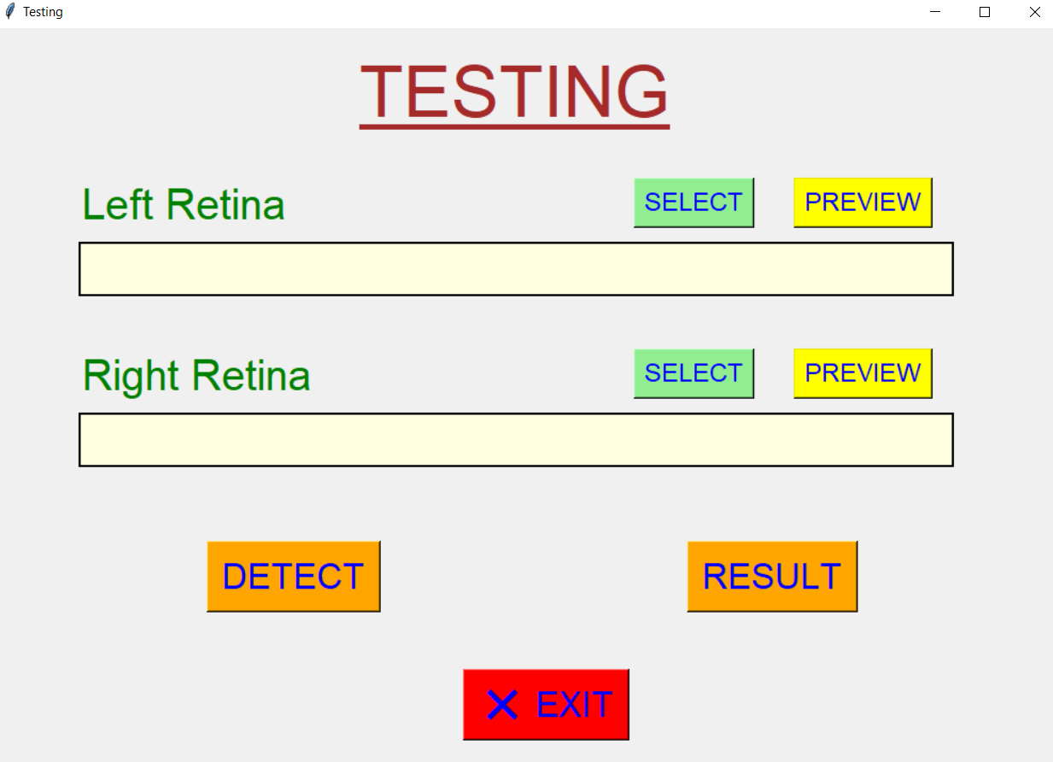

Slide 20
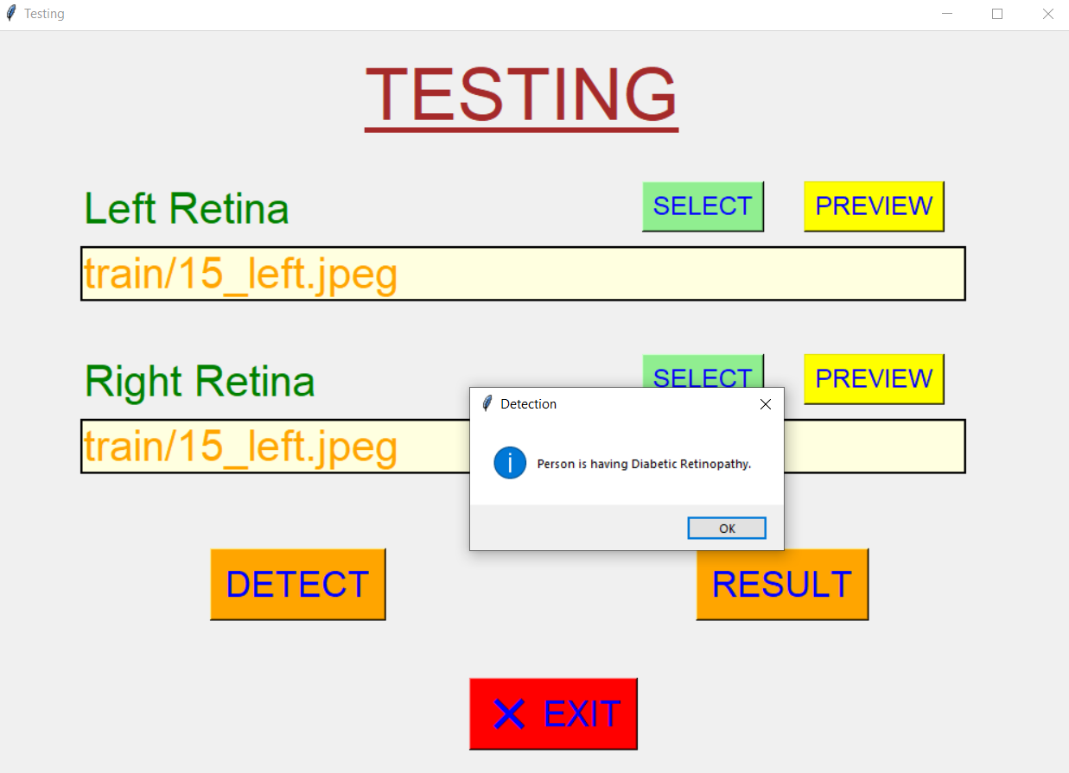

Slide 21
Week 6
We implemented the Result button in the GUI configuration.
Since we know that there are mainly four stages of Diabetic Retinopathy:
Mild Non-proliferative Retinopathy
Moderate Non-proliferative Retinopathy
Severe Non-proliferative Retinopathy
Severe Non-proliferative Retinopathy
So we implemented in such a way, that after detecting whether there is DR or not, it will assign levels to each of the pairs of retina images.
1 – level, 2 – level, 3 – level , 4 – level
And each level corresponds to each of the type of DR. And in that way we found out the type of DR for selected pairs of retina images.

Slide 22
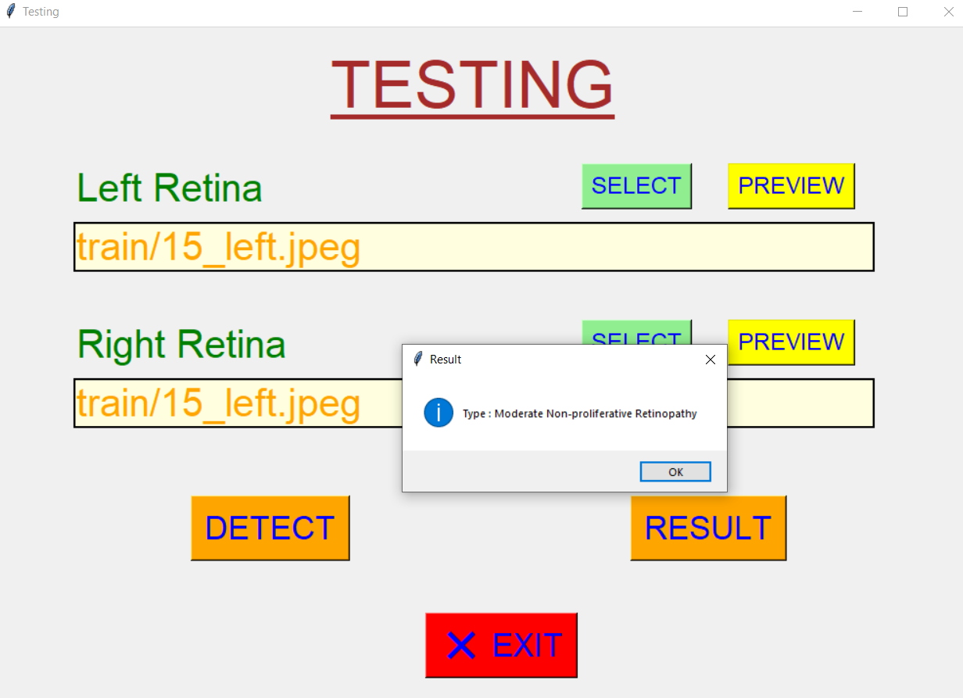

Slide 23
Week 7
Till last week we implemented the testing GUI where we need to select both retina images.
Now we have updated the code, so that it will work even when we select at least one retina image.
For eg.) if we select only left retina image, in the result it will show that left image is not selected, and it will detect if right retina is defected by DR or not.
Same for the vice versa.
And if one selects both the pair of retina , then in result it will show, the result in form of type of DR with which left retina is defected and same for the right retina.

Slide 24
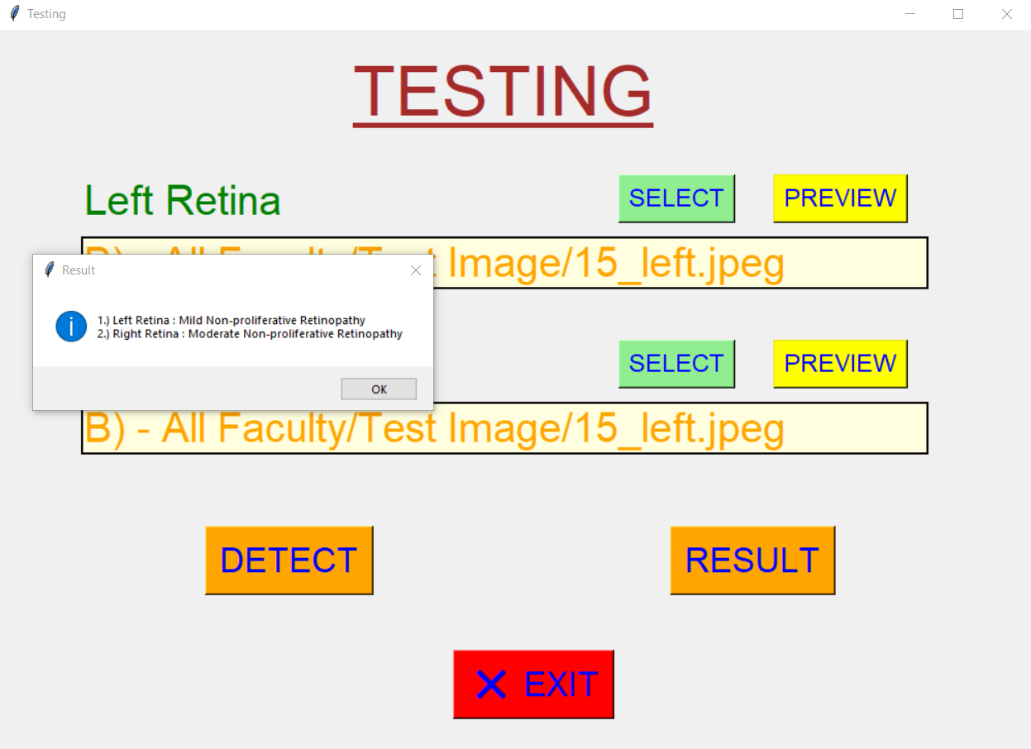

Slide 25
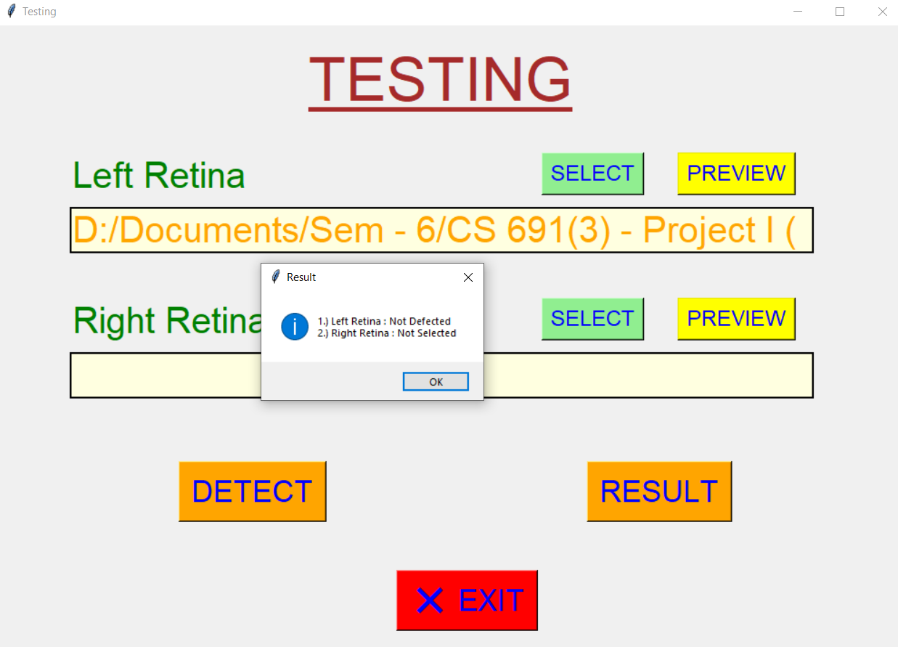

Slide 26
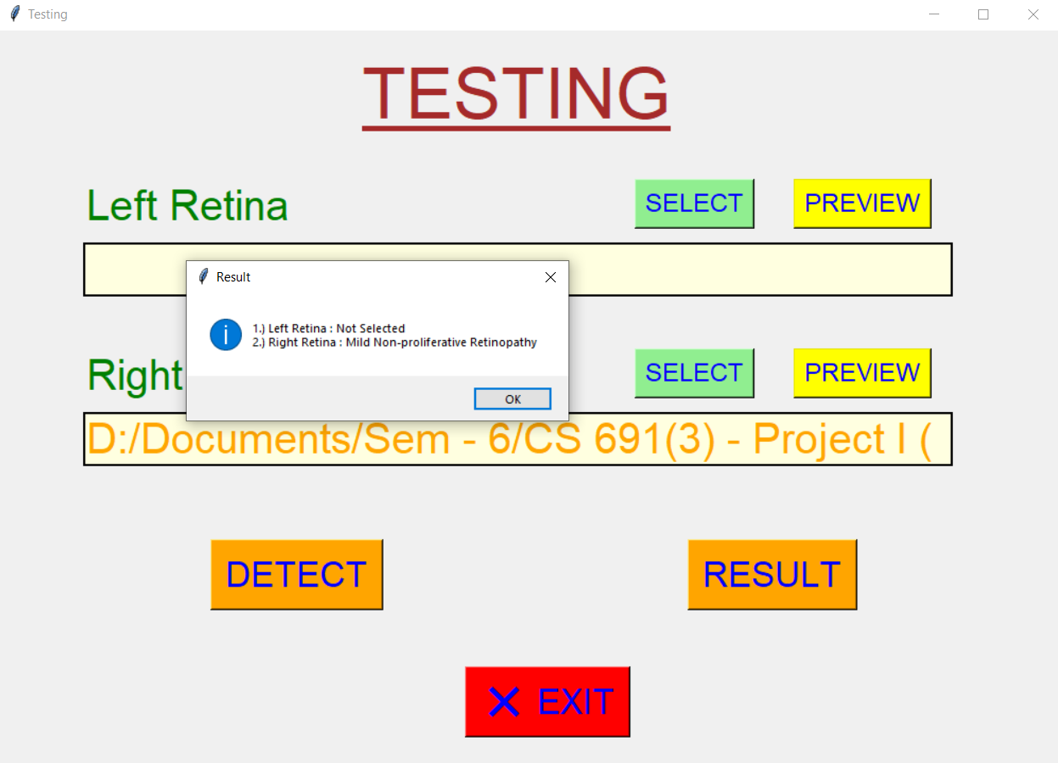

Slide 27
Week 8
Along with this we have started forming the final report following the same template as we did in 5th sem.

